Slide 1
Github: Repositories & Portfolio Websites
James R. Bradley

Slide 2
Github
We will be interacting with github.com in this session, so let’s breakdown the name
git
Version control software
hub
The effective center of an activity, region, or network
Source: google.com
github.com
permits you to use git, while serving as a hub from which you can distribute files

Slide 3
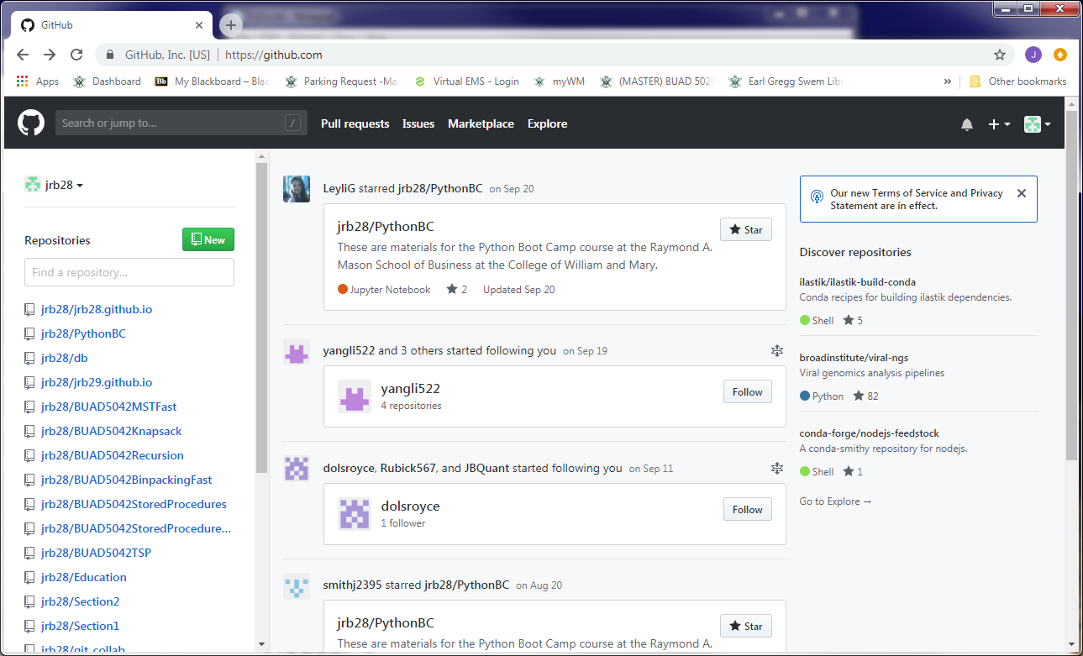
Github
Here is my github.com page
Multiple repositories (repos)
For distributing files

Slide 4
Github
Another use for github.com
Publish a portfolio of your work
Useful in your job search

Slide 5
Github Repositories (Repos)

Slide 6


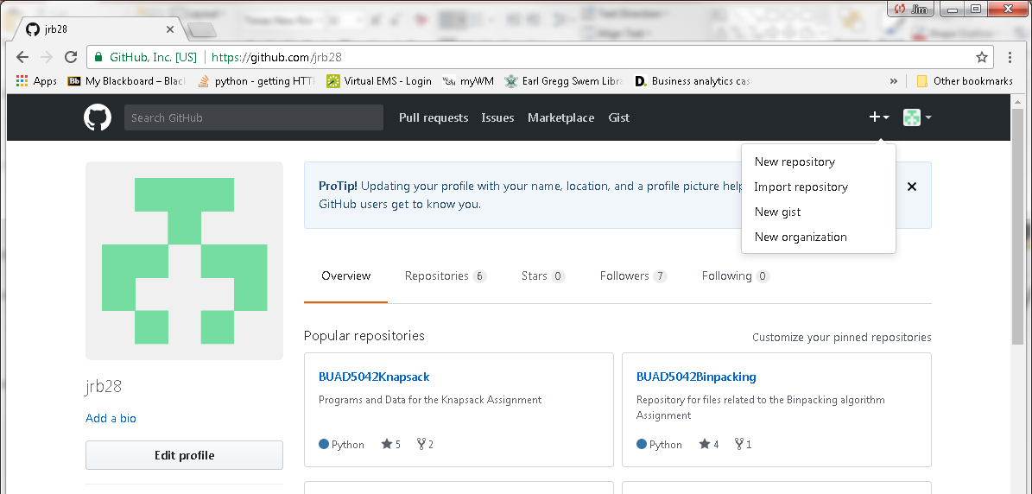
Github Repositories
Create account: go to https://github.com/
Create a repository

Slide 7
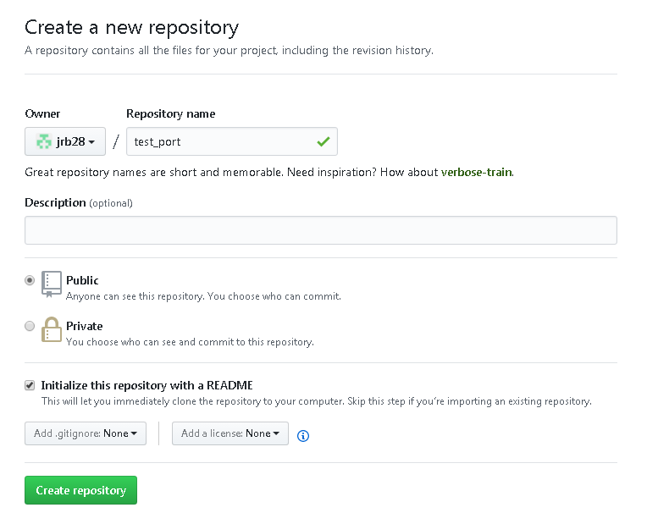
Github Repositories
Choose Public repository (free)
Choose Initialize this repository with a README

Slide 8
Github Repositories
Click on Upload Files button
Select files or drag to browser
Change commit message if desired
Click on Commit Changes button

Slide 9
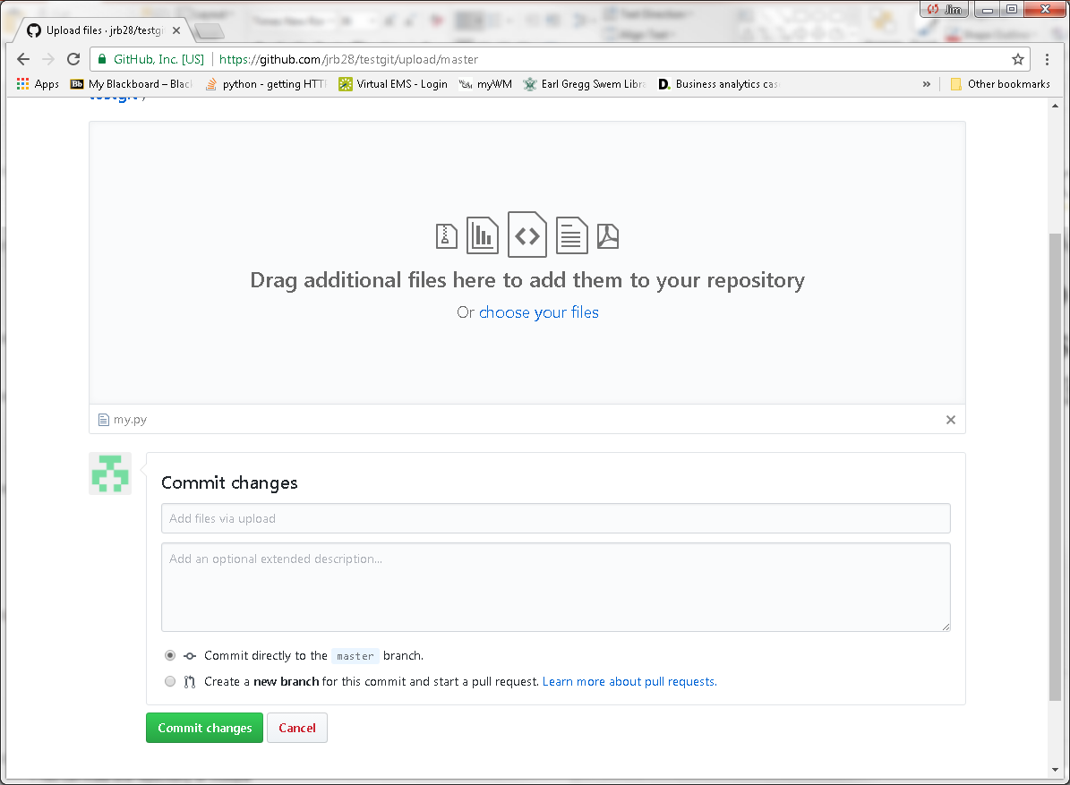
Github Repositories

Slide 10
Portfolio in Github Repository
Repos can be a part of your portfolio
Publish all code and documents on a single project in a repo
Code, Jupyter notebooks, presentations, reports, etc.
Jupyter notebooks in repos are rendered as html web pages
Opportunity to show your work and explain what you did
Use multiple repos
Each focuses on a different topics, job, or project
Organize your files within folders for neatness
All code in a folder
Readme document in root folder

Slide 11
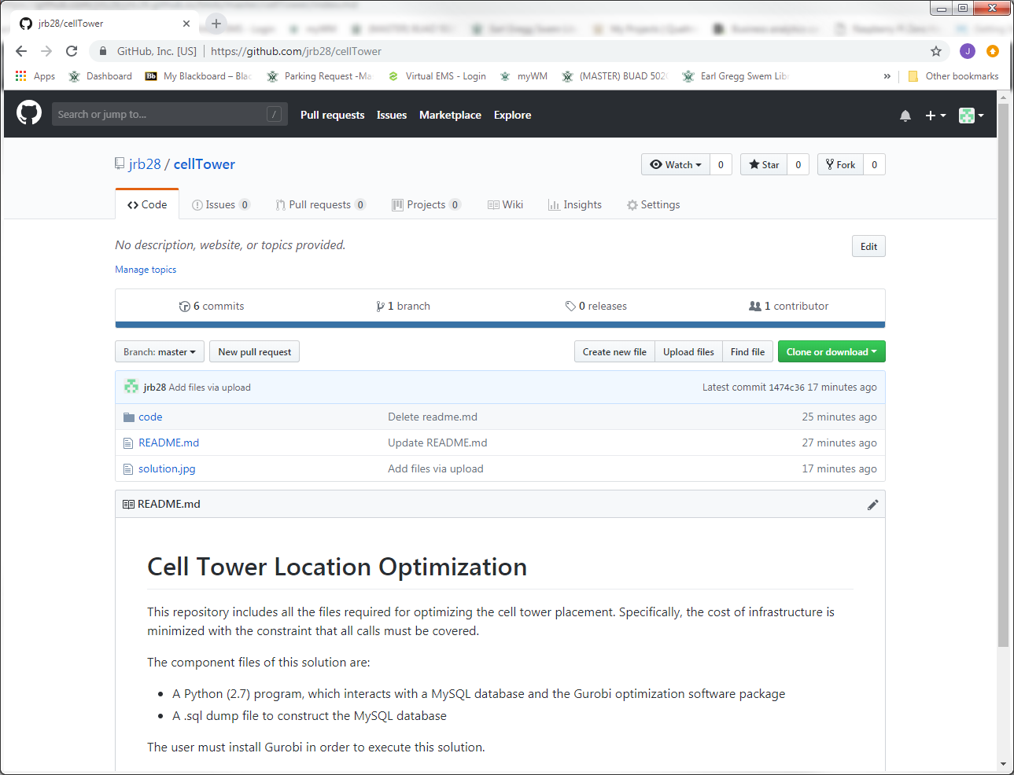
Portfolio in Github Repository
Example Github repo

Slide 12
Github Portfolio Web Sites

Slide 13
Setting Up Your Web Site

Slide 14
Getting Started
Create repository for web site
Populate web site with a template
Modify the template to personalize
Add content to web site

Slide 15
Getting Started
Github.com also allows a web page
Create a GitHub repository with this name:
username.github.io
Browse to your web page
username.github.io
Edit your site:
github.com/username/username.github.io
View your site:
username.github.io

Slide 16
Getting Started
Choose theme
Click on Settings
Go to GitHub Pages section
Click on Change Theme
Download zip file
Right-click and Save Link As
Left-clicking doesn’t work for me (in Chrome)

Slide 17
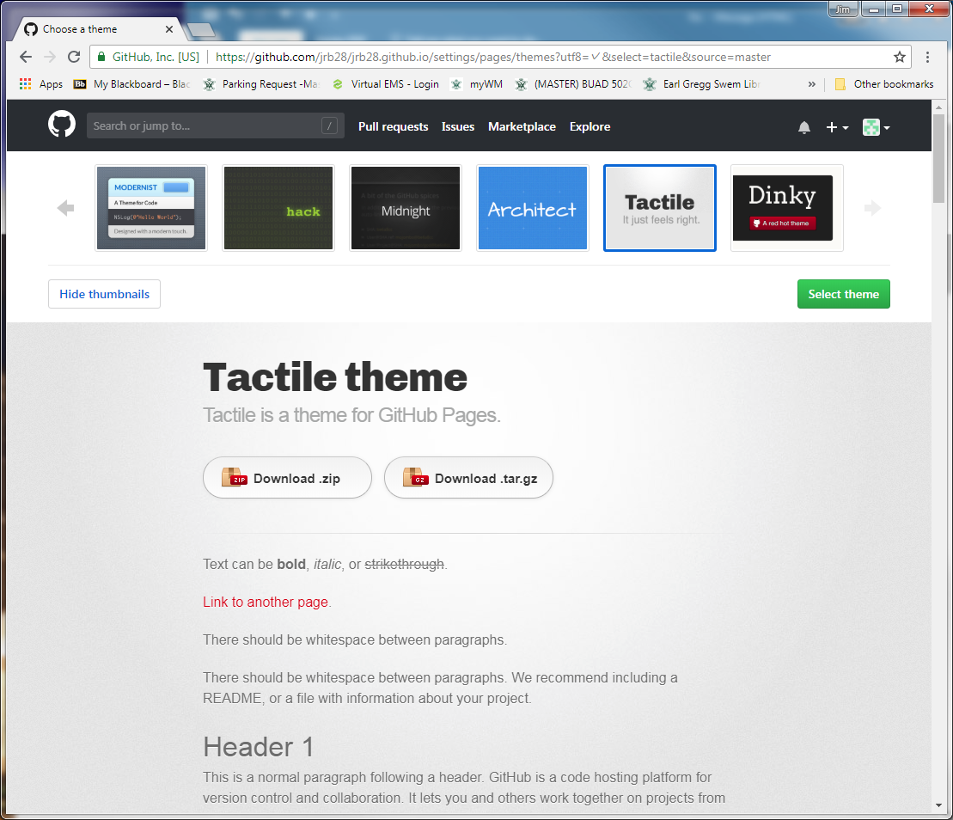
Getting Started
Right-click and Save Link As…

Slide 18
Getting Started
Unzip zip file
Notice file-folder structure: a complete web site
Upload all files & folders to
github.com/username/username.github.io
Commit Changes
You just created your web site
Need to customize it

Slide 19
Getting Started
In browser, go to username.github.io
What’s happening
GitHub/Jekyll converts markdown files (.md) to HTML
index.md is the default web page
Text file: edit it as you wish
index.md
Jekyll
Web Site Generator
HTML
_config.yml
/_sass/*.scss
Sass (Syntactically Awesome StyleSheets)
CSS (Cascading StyleSheets)
SCSS (CSS for Ruby)

Slide 20
Getting Started
Critical files to edit now
index.md
_config.yml (remove download buttons)
Possibly edit this file later
_sass/Jekyll-theme-tactile.scss
Colors, fonts, etc.

Slide 21
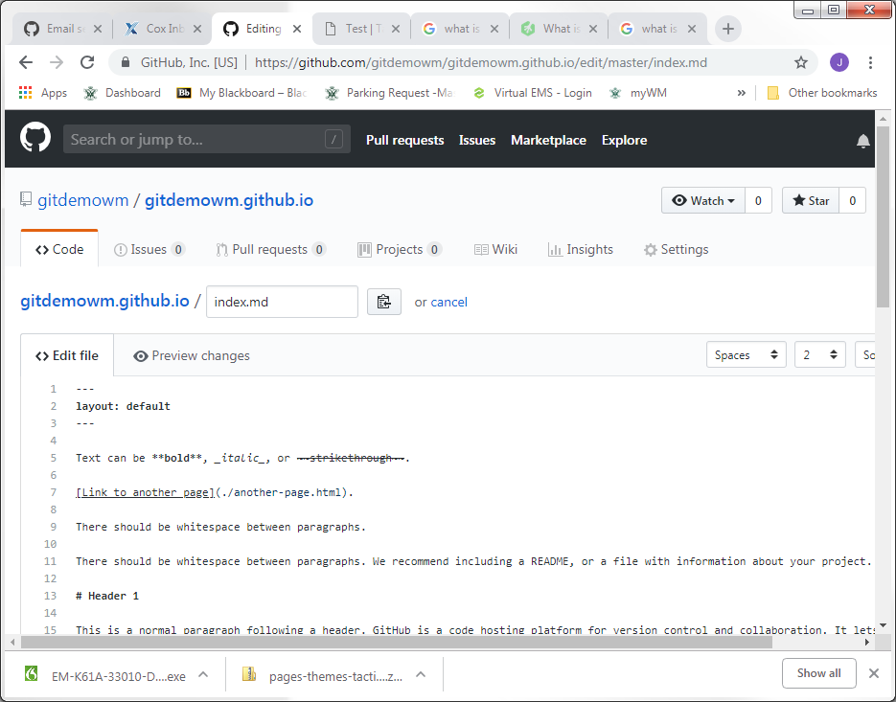
Getting Started
Front Matter
Demarcated by “---” Controls some facets of web page content: Titles, Description, etc.
Markdown Content of web page

Slide 22
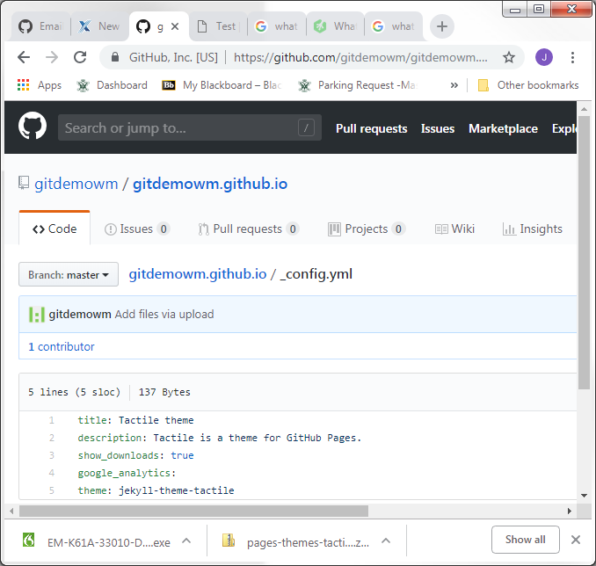
Getting Started
Default Page Settings
Using layout: default in the .md front matter causes document to use all these attributes
Override these settings in .md using commands like: title: My Web Page

Slide 23
Getting Started
View username.github.io again in browser
Note where title and description appear
Note download buttons
Edit index.md using text editor
Edit title and description in front matter
title: Test Title
description: Test Description
index.md must have front matter section
Start and End “---”
Edit _config.yml
Change show_downloads to false

Slide 24
Getting Your Content onto the Web Site

Slide 25
Website Structures
Link web site content to index.md in root folder
Web site origin
Web site structure strategies
Create project or topic web pages from markdown documents
Link to a variety of content
Repository pages (e.g., code)
Jupyter notebooks
Download and visual rendering
Images
Videos

Slide 26
Website Structures
Create project or topic web pages from markdown documents
Create project folder in root directory
Create index.md file within that folder
Edit the index.md file as desired
Link to the project index.md file from the root index.md file
[Alternate Text](path_to_item)
[Time Series](/timeseries/index.md)
Open index.md in timeseries subfolder of current folder

Slide 27
Portfolio Website on Github
Jupyter notebooks
In github web site viewed through web browser
Save .ipynb notebooks as HTML for HTML view
[Jupyter Notebook (html)](TimeSeriesDecomposition.html)
.ipynb files are automatically downloaded otherwise
[Jupyter Notebook (ipynb)](TimeSeriesDecomposition.ipynb)
In repositories
.ipynb files are rendered as HTML
Non-functional

Slide 28
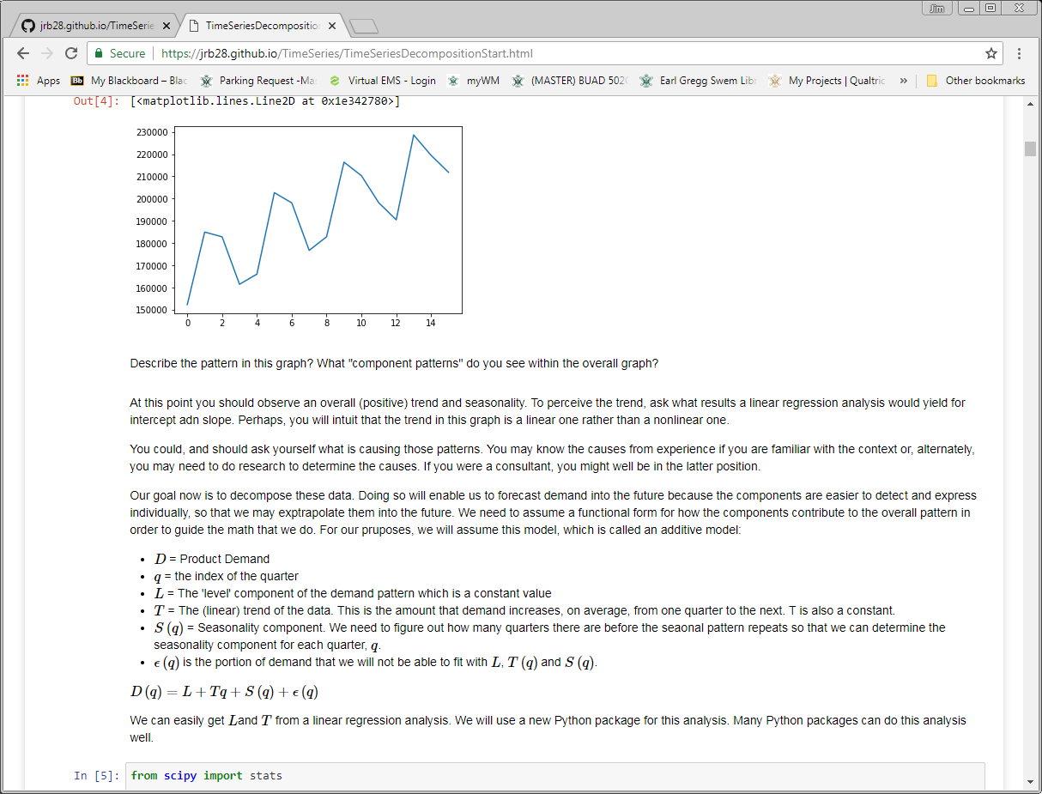
Portfolio Website on Github
Jupyter from a Github web page
Notice URL indicates .html file

Slide 29
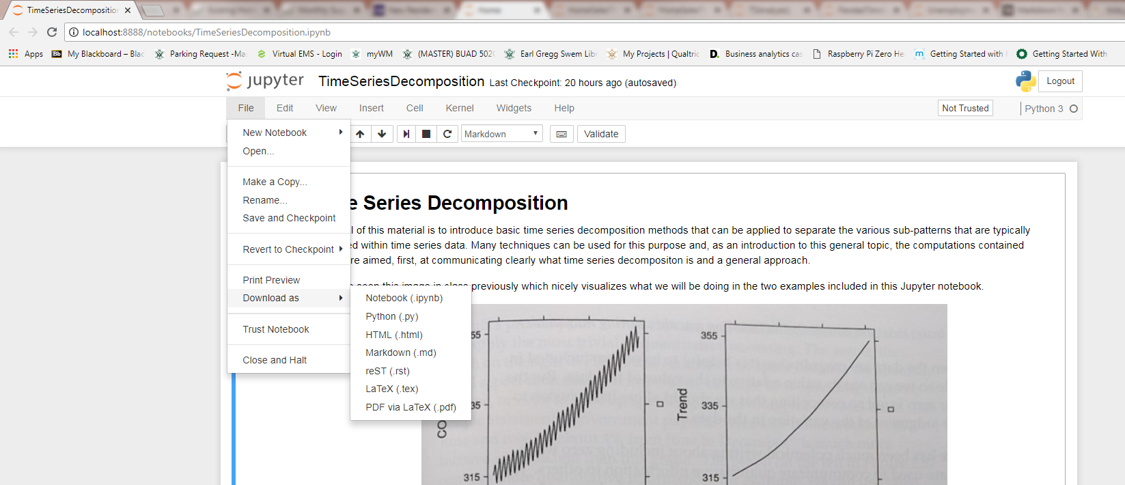
Portfolio Website on Github
How to convert Jupyter notebooks to html

Slide 30
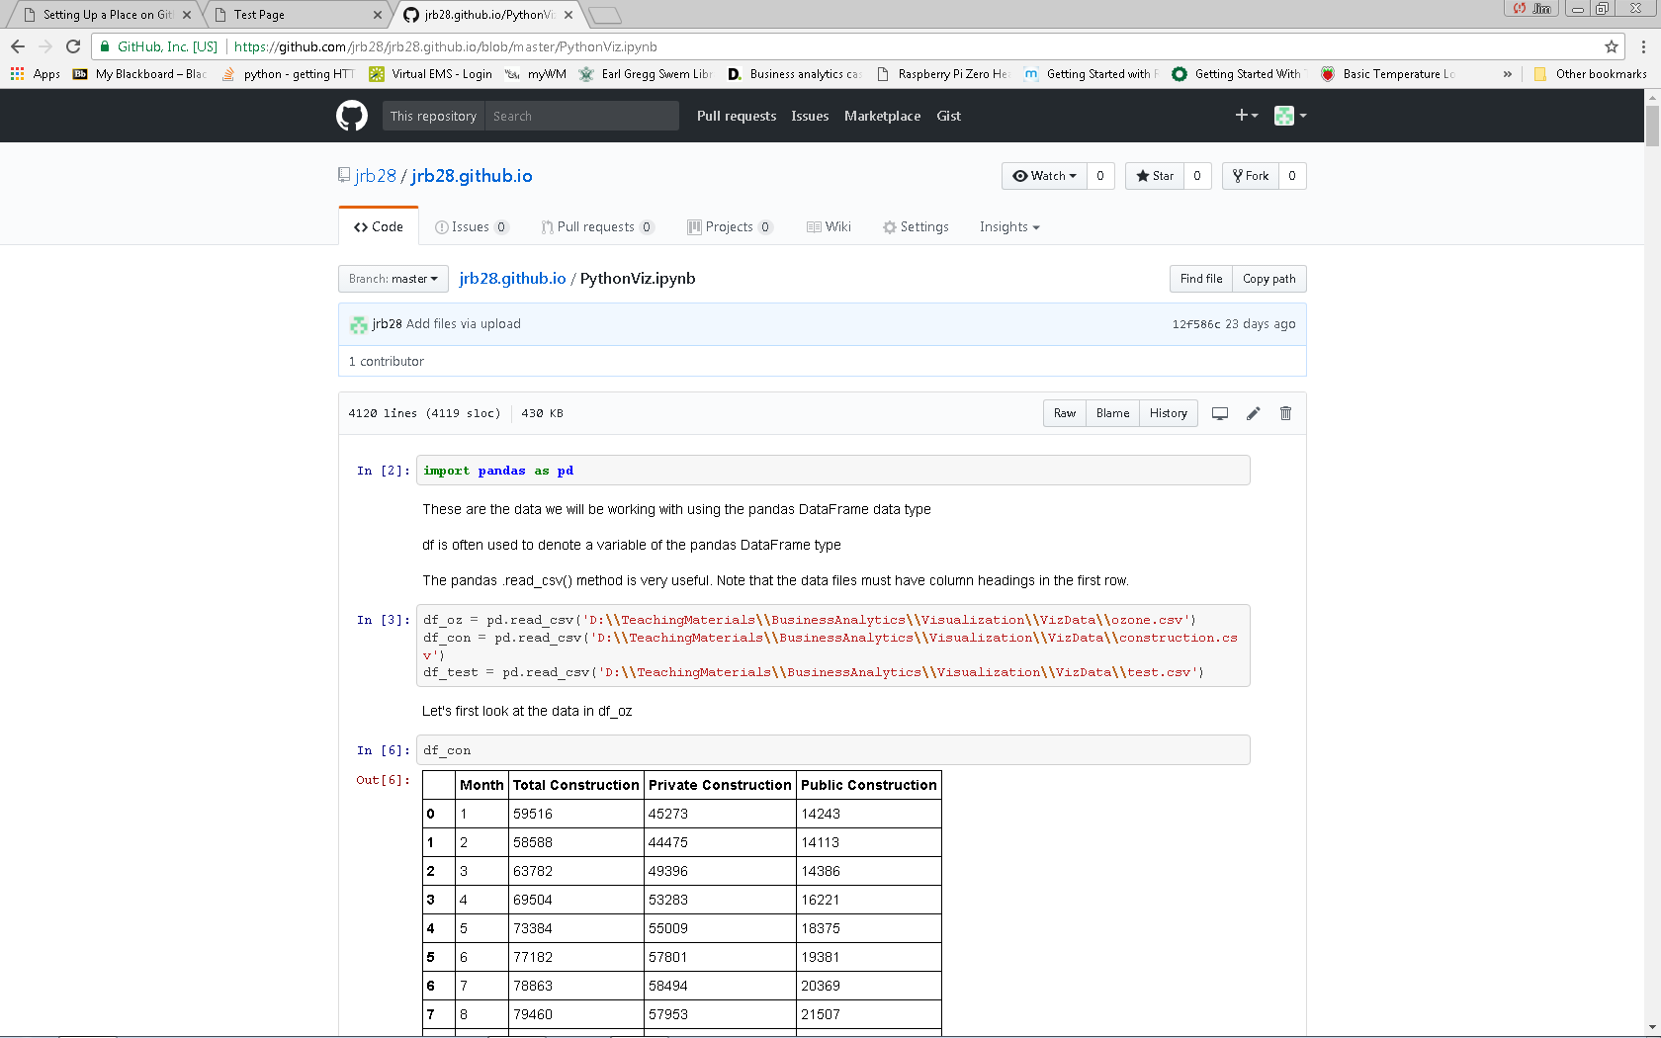
Portfolio Website on Github
Jupyter notebooks viewed in repository

Slide 31
Portfolio Website on Github
Links to images
![Picture](myPic.jpg)
Assuming image is in same folder
Links to videos on youtube
youtube video number is 123 in this example
[![Sorting](https://img.youtube.com/vi/123/0.jpg)](http://www.youtube.com/watch?v=123)
Links to repositories
[Repository](https://github.com/username/repo_name)

Slide 32
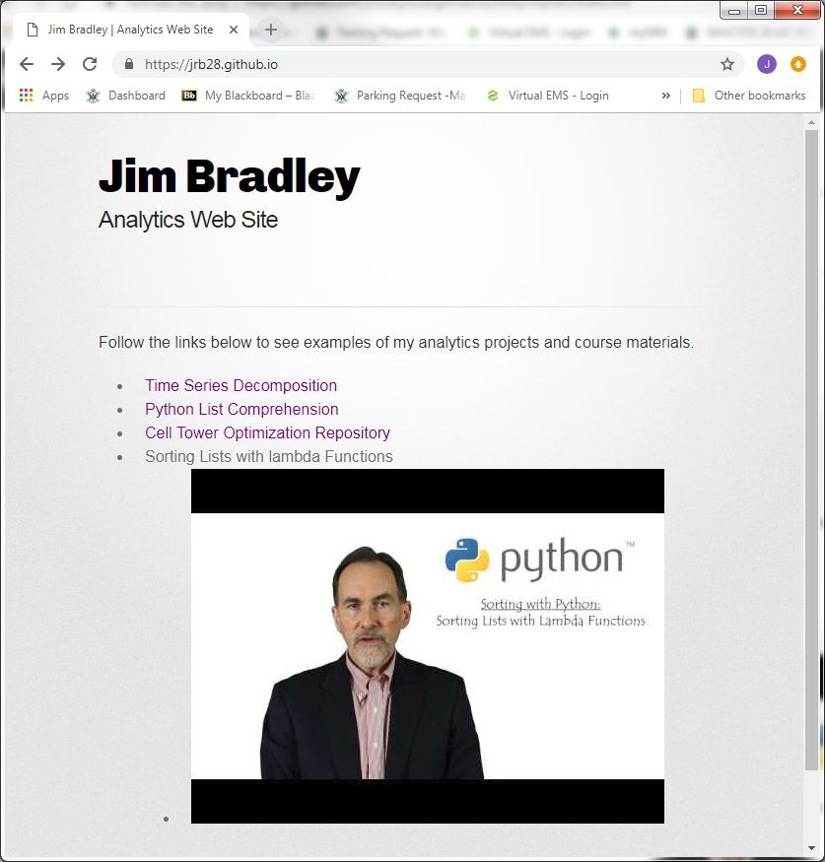
Portfolio Website on Github
My website
See repository for link examples

Slide 33
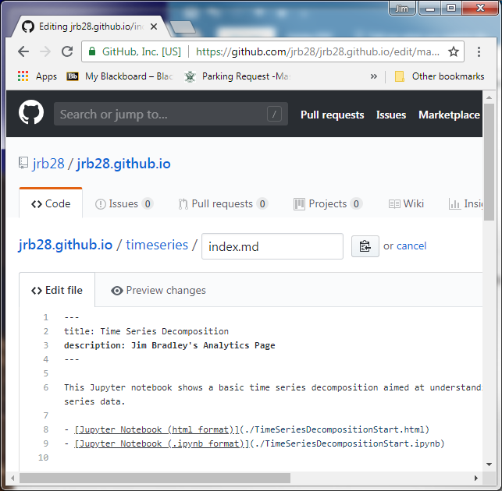
Tips
Each page should have a title and description between the set of three dashes
Edit .scss file in _sass folder for format revisions

Slide 34
Tips
There is a lag from when you load files and edit .md files and when they can be viewed online

Slide 35
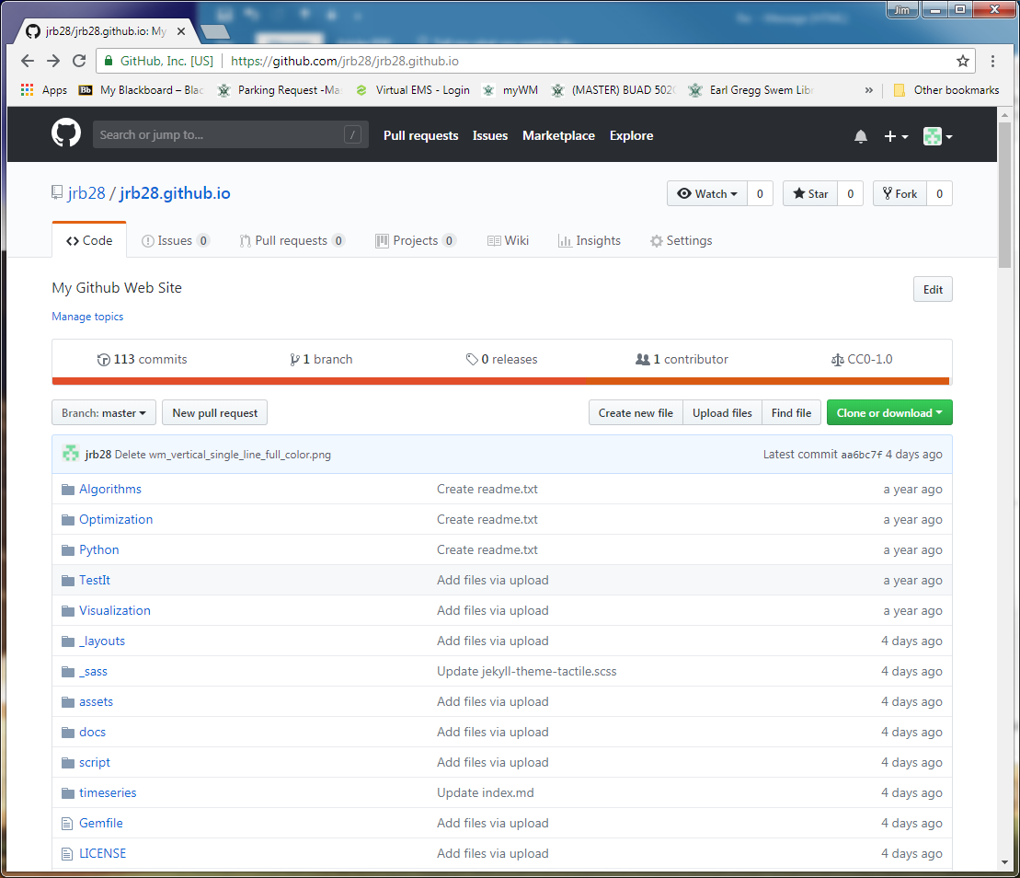
Tips
Manage website
Add files just like other repositories
Uploading content by dragging files from File Explorer to Github folder
Commit changes

Slide 36
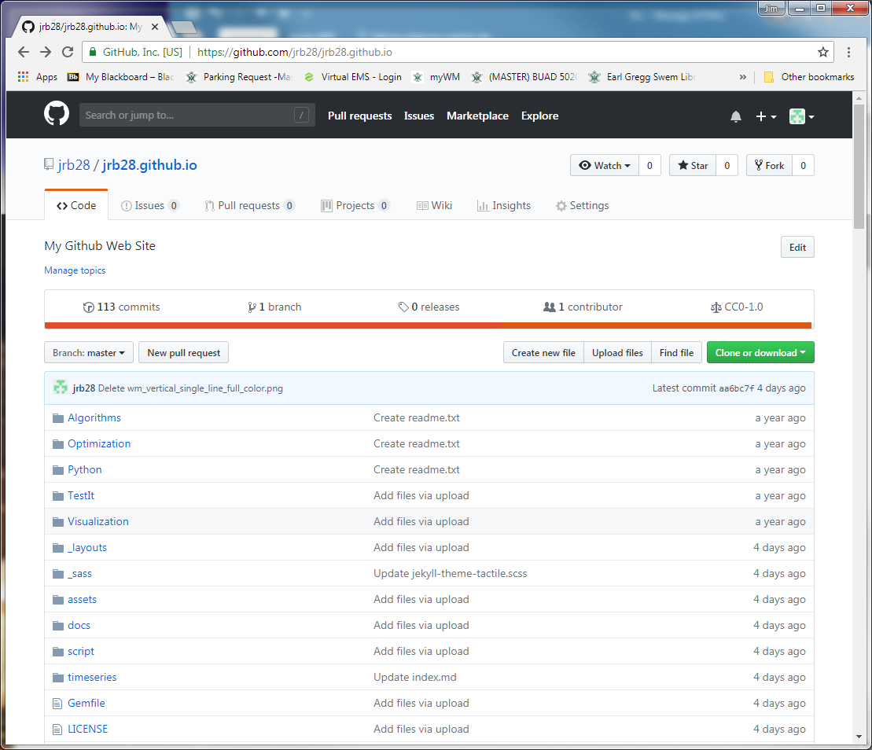
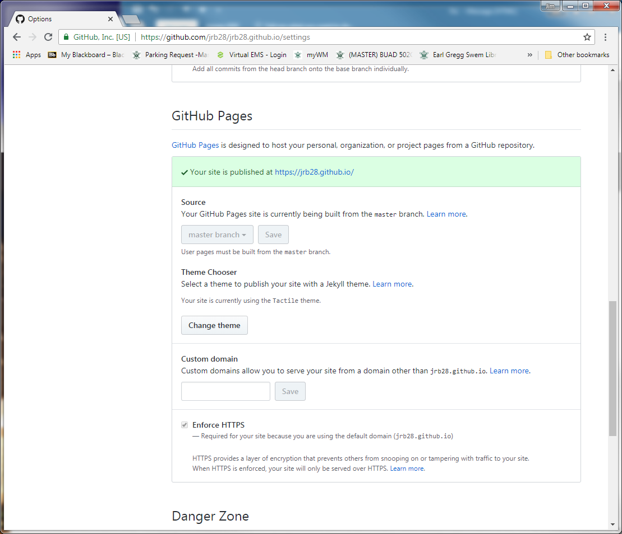
Tips
Change themes

Slide 37
Portfolio Website on Github
Resources & Ideas
https://dannguyen.github.io/github-for-portfolios/
See first tutorial for basics of setting up a Github web page
http://blog.udacity.com/2016/02/how-to-build-a-data-analysis-portfolio-that-will-get-you-hired.html
https://techbeacon.com/what-do-job-seeking-developers-need-their-github
https://help.github.com/articles/working-with-jupyter-notebook-files-on-github/
Jupyter and Github
https://www.dataquest.io/blog/how-to-share-data-science-portfolio/

